Slide 1
Software Requirements
Lecturer: Ngo Huy Bien
Software Engineering Department
Faculty of Information Technology
VNUHCM - University of Science
Ho Chi Minh City, Vietnam
nhbien@fit.hcmus.edu.vn

Slide 2

Objectives
To discover software requirements.
To document software requirements.

Slide 3

Contents
Functional requirements.
Non-functional requirements.
Fit criteria.
Perfect technology.

Slide 4

References
Suzanne Robertson and James Robertson (2012). Mastering the Requirements Process. Addison Wesley Professional.
Steve Tockey (2019). How To Engineer Software - A Model-Based Approach. Wiley-IEEE Press.

Slide 5


Discovering Software Requirements (I)
Developing a new product
Start with a trivial existing solution, or
a similar product.
Enhancing an existing product
Start with the existing product, or
a similar product.
Who are the users?
What are their goals?
How can the future black box software help them accomplish their tasks?

Slide 6

Discovering Software Requirements (II)
Building a new corporate information system (enterprise application) for a client
Start with a manual process, or
a trivial existing solution, or
a similar system.
Enhancing an existing corporate information system (enterprise application) for a client
Start with the existing system, or
a similar system.
Who are the users?
What are their goals?
How can the future black box software help them accomplish their tasks?
Refer to 05.2. Business Use Cases.pptx and 05.3. Domain Models.pptx for details.

Slide 7
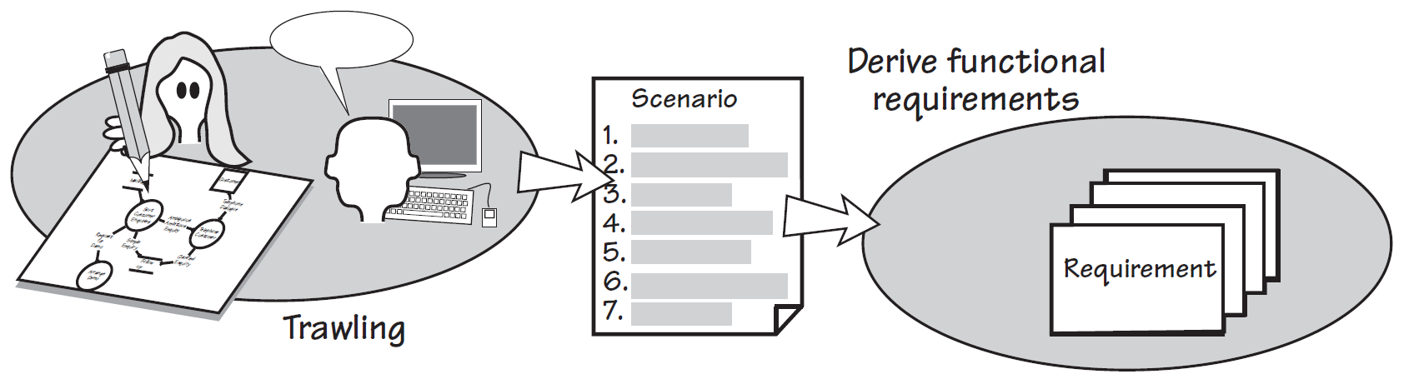
Functional Requirements [1]
Functional requirements specify what the product must do—the actions it must perform to satisfy the fundamental reasons for its existence.
They should be, as far as possible, independent of the technology used by the eventual product.

Slide 8
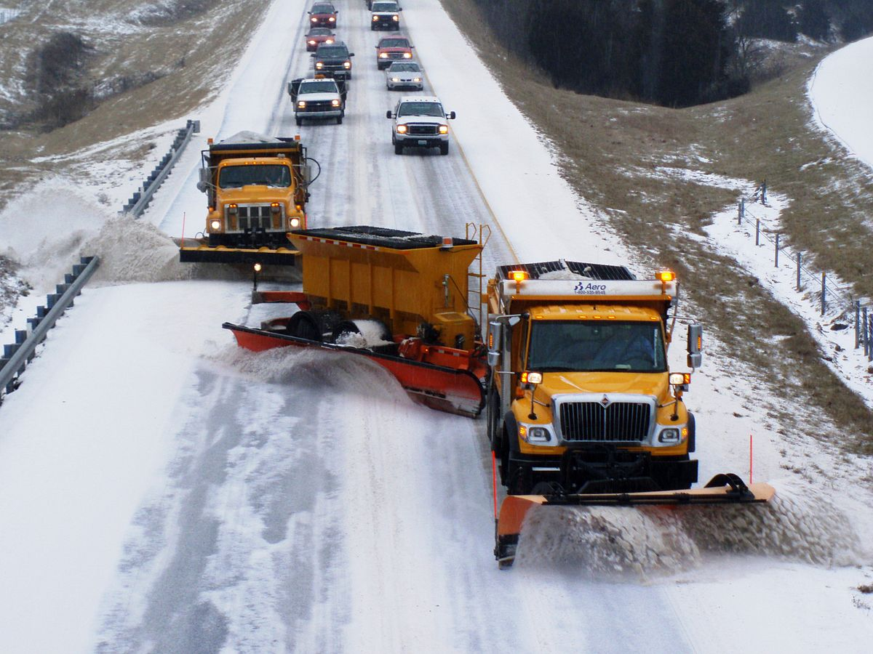
Example
Description: The product shall record roads that have been treated.
Rationale: To be able to schedule untreated roads and highlight potential danger.

Slide 9
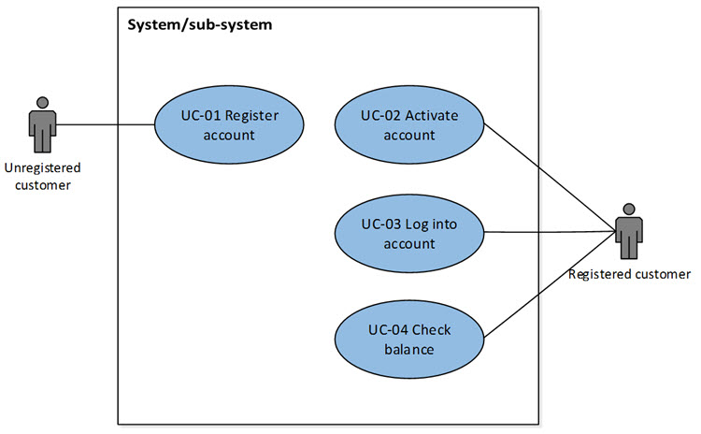
Use Cases
See “06.1. Use Cases.pptx”.

Slide 10


Slide 11

Look and Feel Requirements
The product shall comply with corporate branding standards.
The product shall be attractive to an older audience.
The product shall appear simple to use.
The product shall appear state of the art.
The product shall comply with the [Aqua/Vista/Motif/etc.] guidelines.
The product shall conform to the established look and feel of the organization's products.
Be careful not to design the interface, because you do not yet know the complete requirements of the product.
Designing is the task of the product's designers, once they know the requirements.

Slide 12
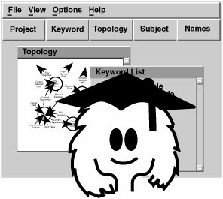
Usability and Humanity Requirements
The product shall be easy to use.
The product shall be easy to use by members of the public who might not read English.
The product shall be easy to learn.
The product shall be easy to use on the first attempt by a member of the public without training.
Ninety percent of a panel that is representative of the general public shall successfully purchase a ticket from the product within 45 seconds of their first encounter.

Slide 13

Performance Requirements
The product shall identify whether an aircraft is hostile or friendly within 0.25 second.
The product shall have the capacity for 5,000 roads.
Speed to complete a task
Accuracy of the results
Safety to the operator
Volumes to be held by the product
Ranges of allowable values
Throughput, such as the rate of transactions

Slide 14
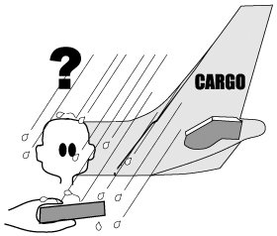
Operational and Environmental Requirements
The product shall be used in and around trucks at night and during rainstorms, snow, and freezing conditions.
The product shall interface with the thermal mapping database.
The product shall conserve battery life.
The operating environment
The condition of the users (Are they in the dark, in a hurry, and so on?)
Partner or collaborating systems

Slide 15
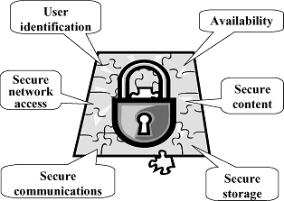
Security Requirements
The product shall ensure that only authorized users have access to the [name of] data (or function).
The product shall deliver data in a manner that prevents further or second-hand use by unauthorized people.
The product shall retain a journal of all transactions for the statutory period.
Confidentiality: Data stored by the product is protected from unauthorized access and disclosure.
Integrity: The product's data is the same as the source, or authority, of the data.
Availability: The product's data and functionality are accessible to authorized users and can be produced in a timely manner.

Slide 16

Documentation, Maintainability and Support Requirements
The product shall include installation guide and user guide.
The product shall be readily portable to Linux.
The product shall be translated into various foreign languages. As yet, the languages are unknown.

Slide 17

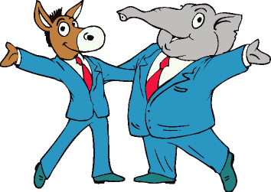
Cultural, Political and Legal Requirements
The product shall not use any terms or icons that might possibly offend anyone on the planet.
The product shall use American spelling.
The product shall comply with the Americans with Disabilities Act.
The product shall comply with our ISO 9001 certification.

Slide 19

Requirements Clarification

Slide 20

Fit Criteria
The measurement of the requirement is the fit criterion.
It quantifies the behavior, the performance, or some other quality of the requirement.
The scale of measurement is the unit you use to test conformance of the product.
If you CAN’T measure a requirement, it is NOT really a requirement.

Slide 21
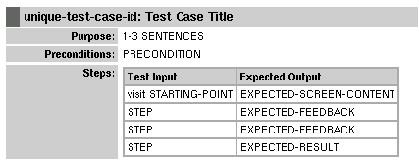
Fit Criteria for Functional Requirements: Test Case
unique-test-case-id: Test Case Title
Purpose – Short sentence or two about the aspect of the system is being tested. If this gets too long, break the test case up or put more information into the feature descriptions.
Preconditions – Assumptions that must be met before the test case can be run.
Steps – Sequence of actions and interactions between actors and the system.
Input
Expected output
Notes and Questions

Slide 22

Fit Criteria for Nonfunctional Requirements: Comparison
The product shall be user-friendly.
New users shall be able to add a road, change a road, and delete a road within 30 minutes of their first attempt at using the product.
The product shall be certified as complying with this year's corporate branding standards by the head of marketing.
Sixty percent of the target audience will recognize the product as belonging to the corporation within five seconds of encountering it for the first time.

Slide 24
Non-requirements [2]
Requirements need to be
Unambiguous
Interpretable in only one way
Testable
Compliance (or, non-compliance) can be clearly demonstrated
Binding
The customer is willing to pay for it and is unwilling to not have it
Per the above definition, the following are not requirements
The system shall be fast
The system shall be user friendly
The system shall be maintainable
The system shall be blue (assuming no one really cares what color it is)

Slide 25
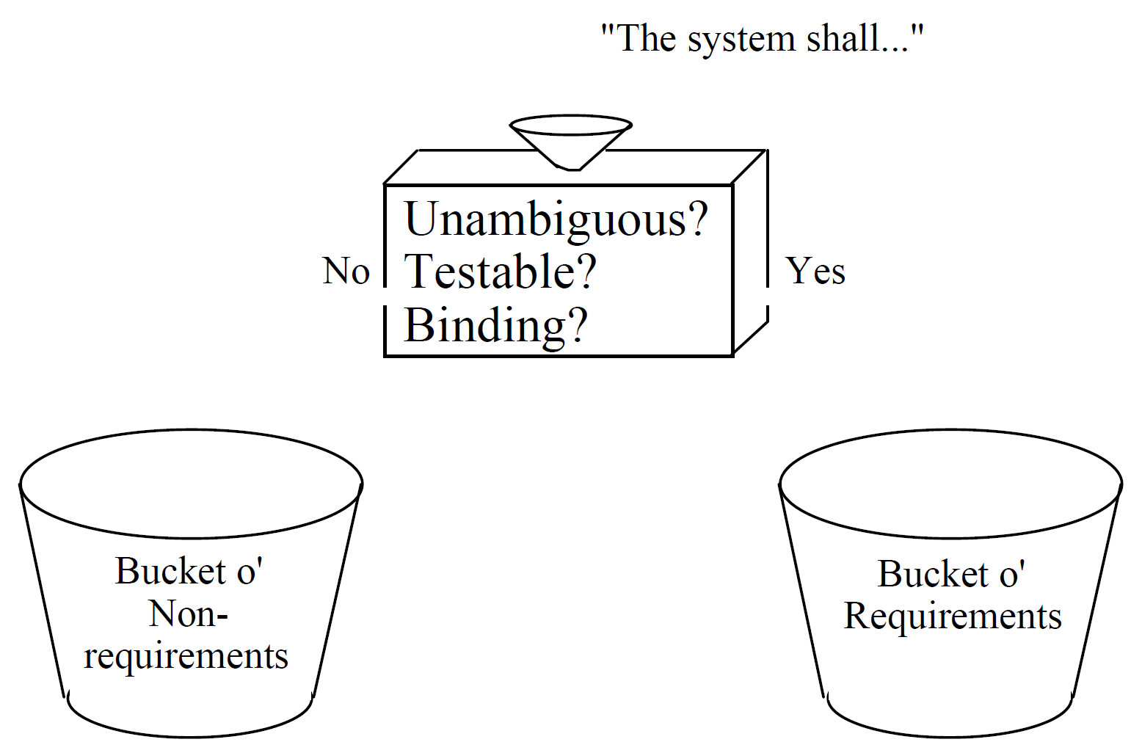
Decision Process, Version 1
Requirements should be separated from non-requirements.

Slide 26
Essential Requirements
"If we had perfect implementation technology (e.g., a computer with infinite speed, unlimited memory, transparent interface, no failures, and no cost), which of the requirements would still need to be stated?"
Steve McMenamin and John Palmer
Every requirement that is still necessary in spite of “perfect technology” is an essential requirement.
If we had this perfect computer …
Would an ATM still need to process deposit, withdraw, and account query requests?
Would ATM transaction records still need to be archived to mag-tape after 7 days?
Would an ATM be usable 95% of the time?
Would an ATM still need to record how often customers use their cards?

Slide 27
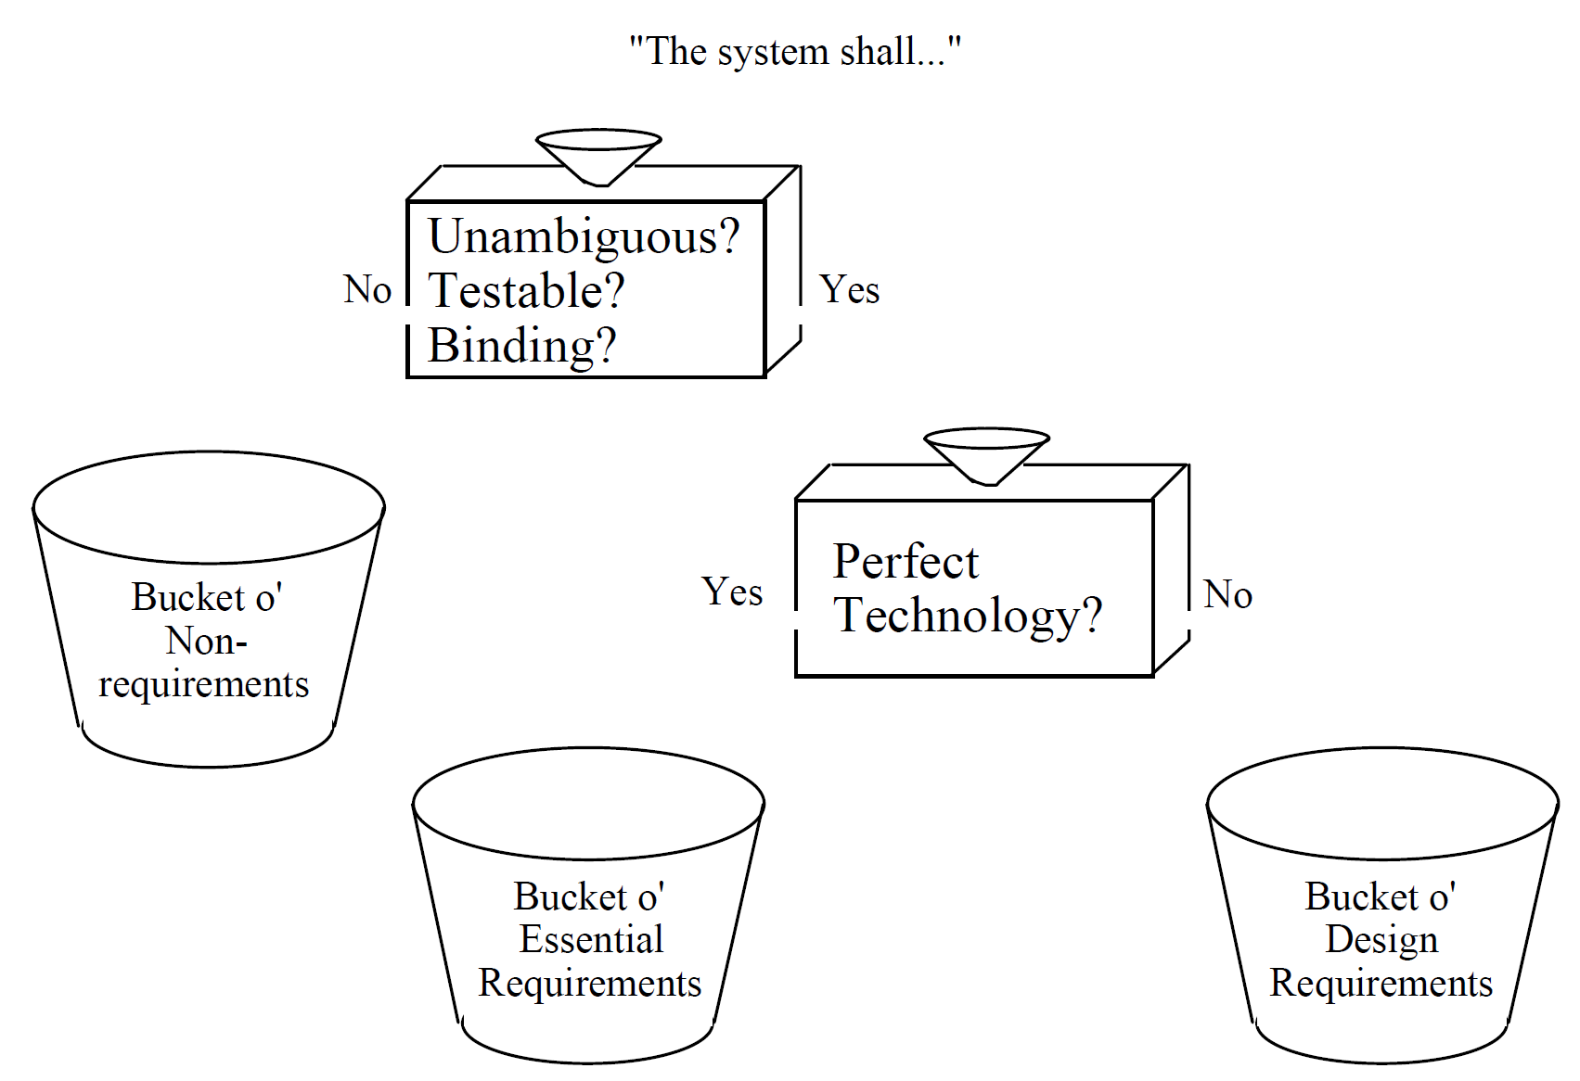
Decision Process, Version 2
The decision criteria is whether or not the requirement would still exist if we had that perfect computer.

Slide 28
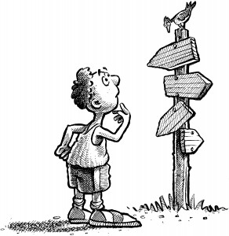
Implications of Perfect Technology
Requirements about speed, cost, and capacity go into the design bucket
Requirements about reliability (MTBF, MTTR) go into the design bucket
Requirements about I/O mechanisms and presentations go into the design bucket
Requirements about computer languages go into the design bucket
Requirements about archiving go into the design bucket
Requirements about the customer's business policy, business process go into the essential bucket

Slide 29

Why Bother?
Reduce apparent complexity: one large problem becomes two smaller ones
Understand the customer’s business policy / business process
Figure out how to automate that business policy / process with the available technology

Slide 30
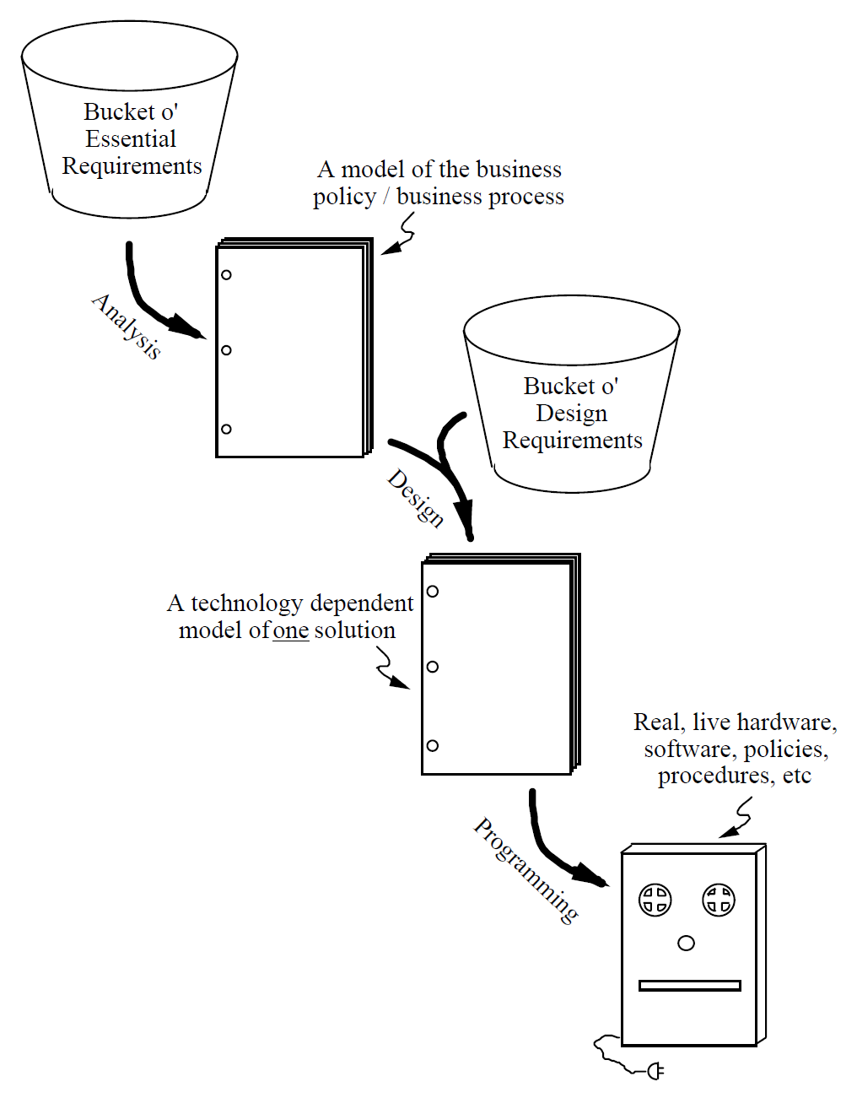
Analysis vs. Design
Analysis and Design can be defined in terms of the kind of requirements being addressed.
But this does not necessarily imply a waterfall lifecycle (note: “activity”, not “phase”).

Slide 32
Further Reading
David Lorge Parna and Jan Madey (1995). Functional Documents for Computer Systems.
NAT, REQ, IN, OUT and SOF.
Carl A. Gunter et al. (1998). A Reference Model for Requirements and Specifications.
WRSPM reference model.

Slide 33

Thank You & See You Again

